Slide 1
TIMES TABLES WORKSHOP

Slide 2
Multiplication Tables Check Explained
What is the purpose of the Multiplication Tables Check (MTC)?
Primary-school children are expected to know all their times tables (and related division facts) up to 12x12. Under the current National Curriculum, children are supposed to know their times tables by the end of Year 4, but are currently are not formally tested on them.
The purpose of the MTC is to determine whether year 4 pupils can fluently recall their multiplication tables. Although the check will help schools to identify pupils who require additional support, it is not intended as a diagnostic tool.
Which children will sit the multiplication check?
The times tables test will be introduced in English schools only. It will be taken by children in Year 4, in the summer term (in June).
In June 2019 the multiplication check will be voluntary (schools will be able to decide whether to administer it or not). In June 2020 it will become compulsory for all English schools

Slide 3
Multiplication Tables Check Explained
How will children be tested?
Children will be tested using an on-screen check, where they will have to answer multiplication questions against the clock. The test will last no longer than 5 minutes and their answers will be marked instantly.
Can children practise before the test?
Before the test window opens each year, there will be the opportunity for children to access a practice area to become familiar with the style of the KS2 times tables test.
We will build in time for this familiarisation, so the check style is not ‘new’ when children take the actual check. This is another reason the current year 4’s will sit the trial this year.
The results from the practice area will not be reported on or available to schools, so this cannot be used as an ongoing tool for assessment before the actual check.

Slide 4
Multiplication Tables Check Explained
What tables will be tested?
There Will Not Be An Equal Spread Of Each Multiplication Table Within The Check
The check has been designed to focus on times tables that fit within the KS2 curriculum.
The 6, 7, 8, 9 and 12 times tables are more likely to be asked than the 2, 3, 4, 5, 10 or 11 multiplication tables. The STA state that there is a focus on these as these are the ‘most difficult’ multiplication tables.
There will always be questions from the 3, 4, 5, 6, 7, 8, 9, 11 and 12 multiplication tables in each test.
There will be no questions from the 1 times table (i.e 1 x 8 or 8 x 1)
There will only be a maximum of 7 questions from the 2, 5 and 10 times tables.
Reversal of questions using the commutative law will not feature in the same check. This means that, for example, 8 x 3 and 3 x 8 won’t be asked to the same pupil.

Slide 5
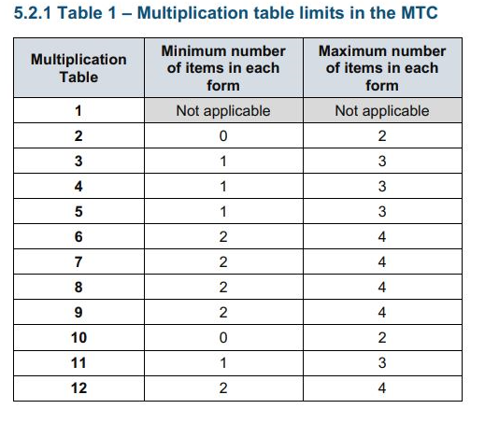
Multiplication Tables Check Explained
Breakdown

Slide 6
Multiplication Tables Check Explained
Which facts are the most likely to appear?
Eleven Facts Are More Likely To Appear Than Others
The framework sets out that the second number in the multiplication will be monitored to ensure that the instances of each number is +/- 1 of the parameters discussed above.
This means that the following 11 multiplication questions (and their commutative equivalents) are more likely to be asked: –
6 x 6, 6 x 7, 6 x 8, 6 x 9, 6 x 12
7 x 8, 7 x 9, 7 x 12
8 x 9, 8 x 12
12 x 12
Of course, not each set of questions will feature all of these facts, and other questions will be asked, but it is likely that a good proportion of the above will be present in each set of questions.
Questions involving 2, 5 and 10 are least likely to be asked, with there only being a maximum of 8 (including the +/-1 parameter mentioned above) of these questions in each test.

Slide 7
Multiplication Tables Check Explained
What happens with the results?
You will only access the result for each pupil at the end of the 3-week window. The child (or teacher) will not be shown the total score on screen. This means there will be a bit of a waiting game to find out how your children have done.
The guidance is clear that there is no expected pass rate or threshold. This means that, unlike the KS1 Phonics Screening check, children will not be expected to re-sit the check if they do not meet a set threshold in this KS2 Times Tables Test.
BUT
National And Local Authority Results Will Also Be Published
From 2020, the DfE will report on the performance of pupils in the check nationally and in each local authority. There is no guidance at this point as to what form these reports will take, but we can infer from the test framework that is likely to include the percentage of children who achieve full marks.
Through Analyse School Performance (ASP) schools are also likely to be able to see the percentage of children in their cohort who achieved each score compared to the percentage of children nationally.
The STA state that this national and local authority data will enable schools to benchmark the performance of their pupils, but it will not form a formal pass mark.

Slide 8
Why times tables?
Having a secure understanding of times table and division facts underpins:
Formal written methods of multiplication and division.
Multiples, factors, factor pairs, common factors, prime numbers.
Square numbers, cube numbers.
Multiply and divide by 10, 100 or 1000.
Percentages.
Conversion of measures.
Multiply fractions, divide fractions, simplify fractions, add fractions, subtract fractions, compare and order fractions.
Area, perimeter and volume.
Ratio and proportion.
Algebra.
Mean (average).
Estimation.
Solve multistep problems.

Slide 9
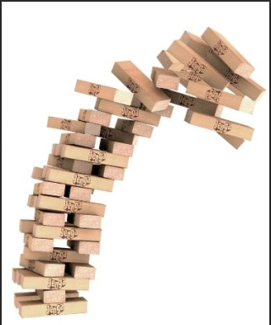
Without the foundations the tower will collapse!
In 2018, 62 marks involved the use of multiplication and division, this was 56% of the marks.

Slide 10
How are tables and division facts taught?
Conceptual understanding
If children are conceptually taught multiplication, and are supported to make, understand and use the relationships and links within multiplication, they will gain the ability to rapidly recall their multiplication facts, and will be able to use them to help them calculate in other areas of maths as well.
In lessons children will be taught
Repeated addition
Inverse relationships (Division)
Number Families
Patterns
Derive Facts from those already known
Commutative Law
4 x5 = 20 = 5 x 4

Slide 11
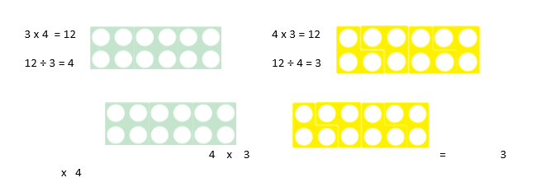
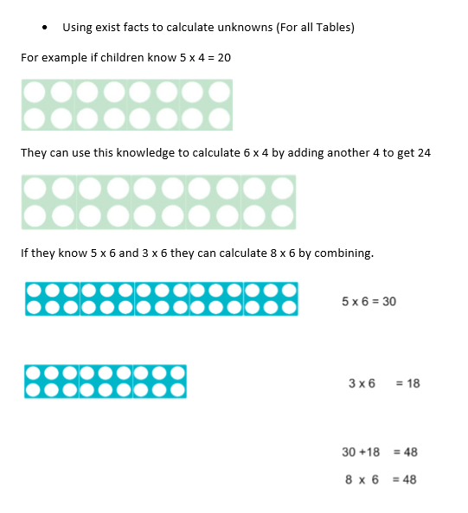
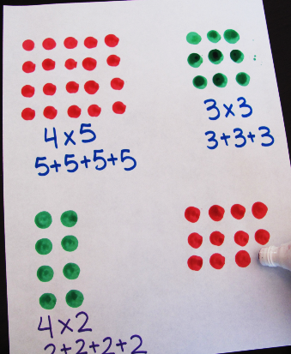
How are tables and division facts taught?
Concrete – Pictorial- Abstract

Slide 12
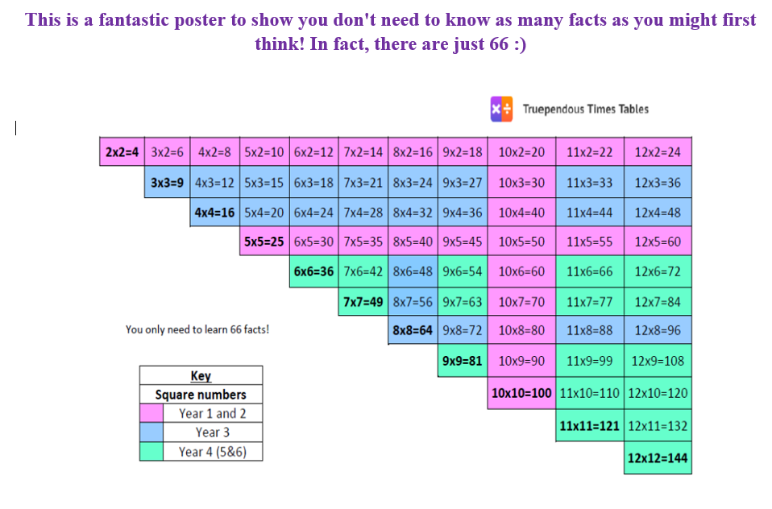
Commutativity

Slide 13
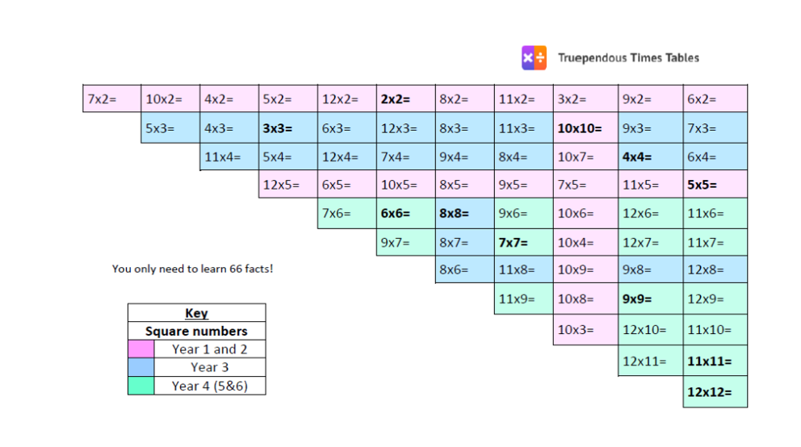

Slide 14
Useful Tips for home
Stick to one table at a time to minimise confusion.
Start with chanting and writing them out slowly in order.
Then move on to completing the answers quickly in order – on paper or verbally with your child.
Finally, move on to completing the answers in any order.
Keep reminding your child that 3 x 4 is the same as 4 x 3 – this is effectively halves the number of tables facts.
Each table has a square number 3 x 3, 7 x 7 etc. These are special numbers that can act as a memory hook – emphasise them!
Talk about the numbers as you are encountering them “ 5 x 7 = 35 that’s our house number” – this makes more memory hooks

Slide 15
Of course Practise makes perfect!
Counting
Singing
Chanting
Speed Tests
Board Games
Card Games
Times Table Tricks
Online
ttrockstars
Teaching Tables
Topmarks
Youtube songs
Links are on our website on
Kidszone

Slide 16
Thank You for coming!

